Slide 1

IBM Coursera Advanced Data Science Capstone Project
Advanced Data Science Capstone –
Building Music Recommendation Application
Mark Bray

Slide 2
IBM Coursera Advanced Data Science Capstone Project
OUTLINES
DATA SET
USE CASE
DATA EXPLORATION
DATA CLEANSING
MODEL DEFINITION
MODEL TRAINING
MODEL EVALUATION
HYPERPARAMETER TUNING
CONCLUSION

Slide 3
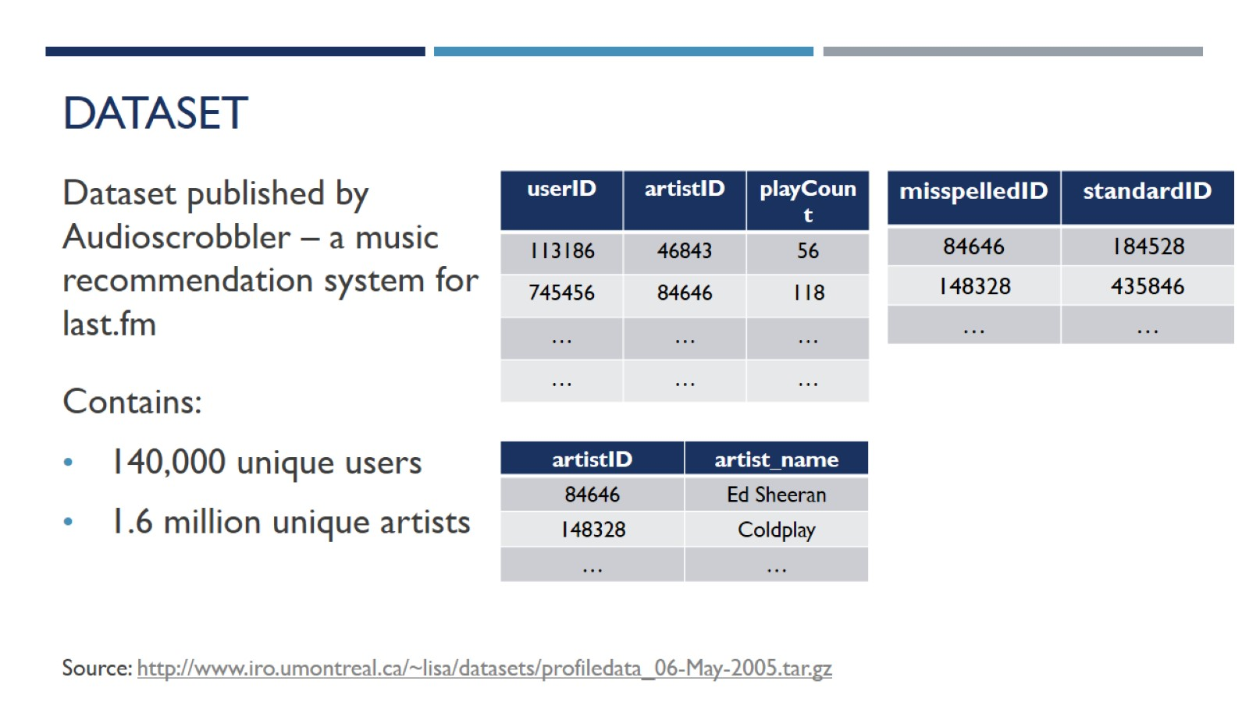
Dataset

Slide 4
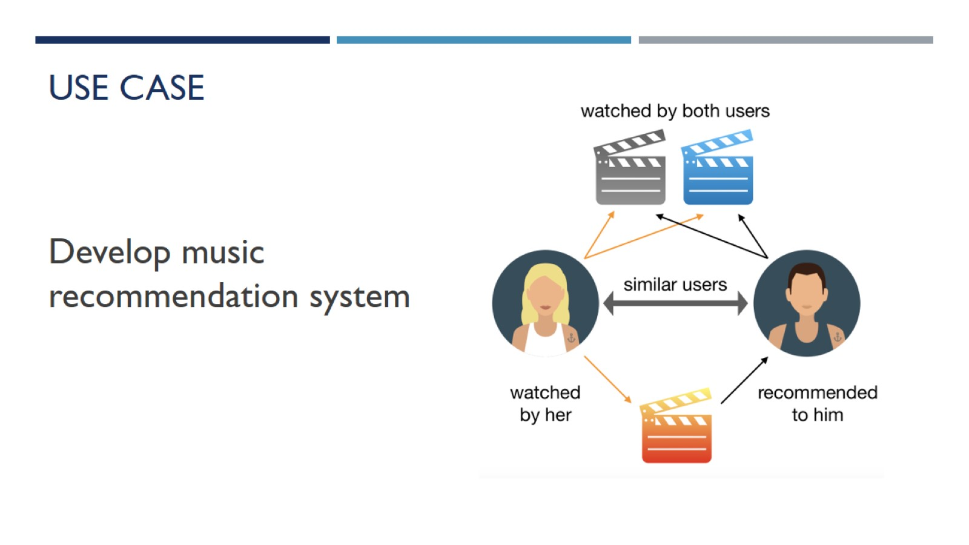
Use case

Slide 5
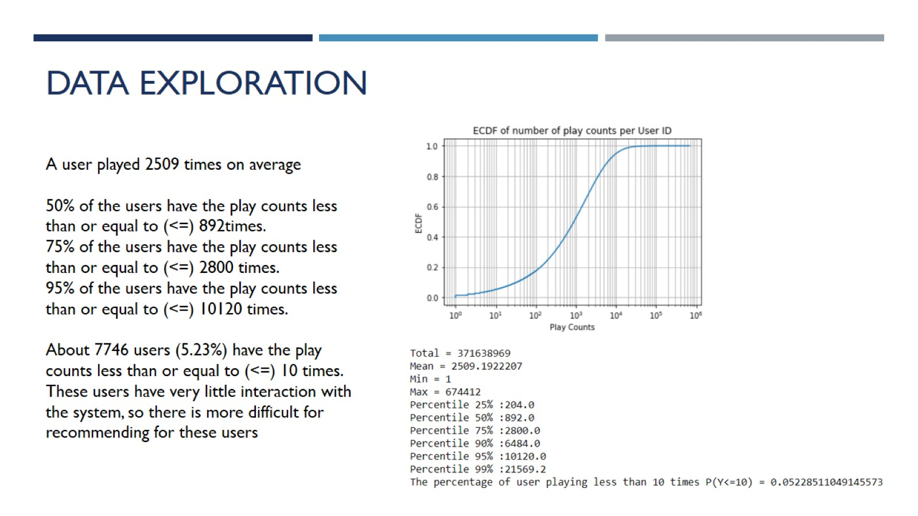
Data exploration

Slide 6
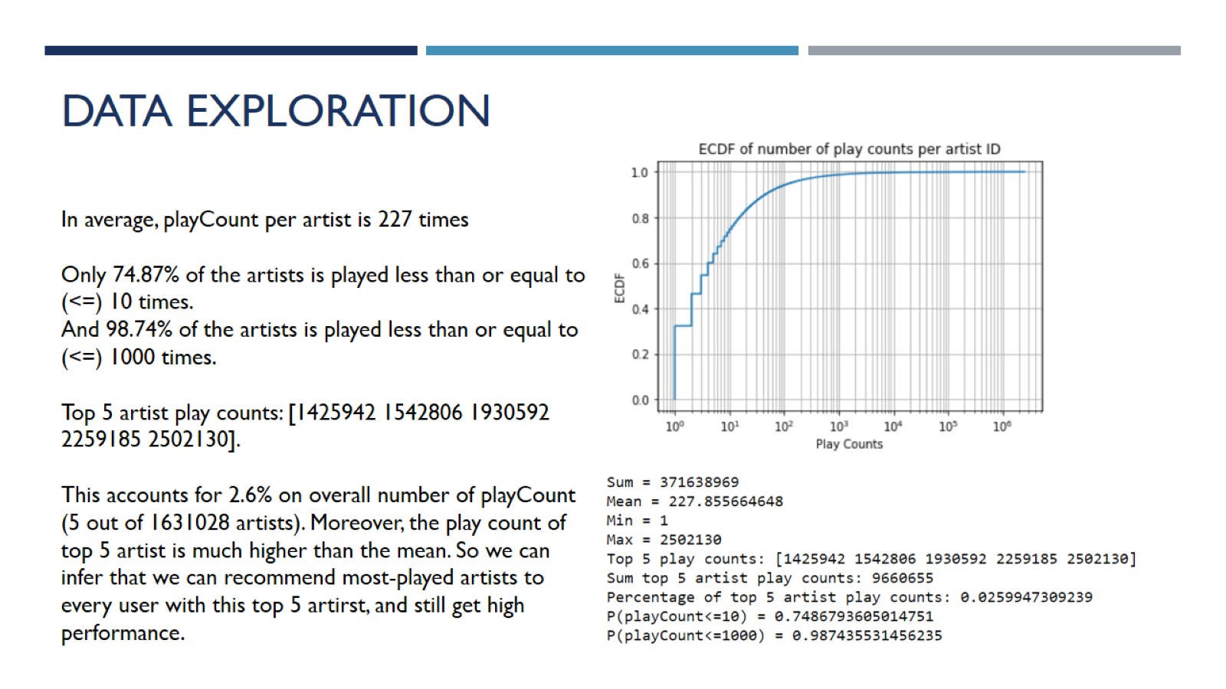
Data exploration

Slide 7
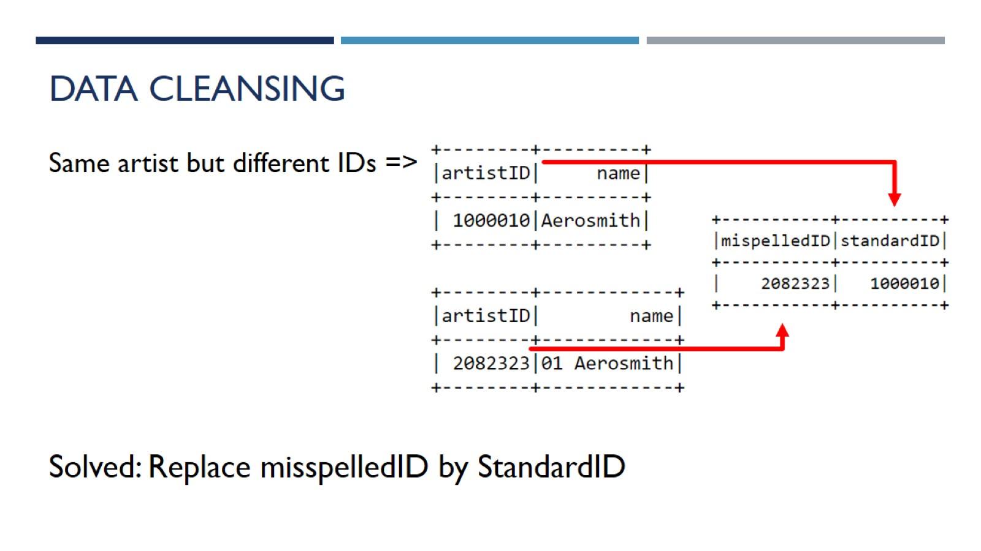
Data Cleansing

Slide 8
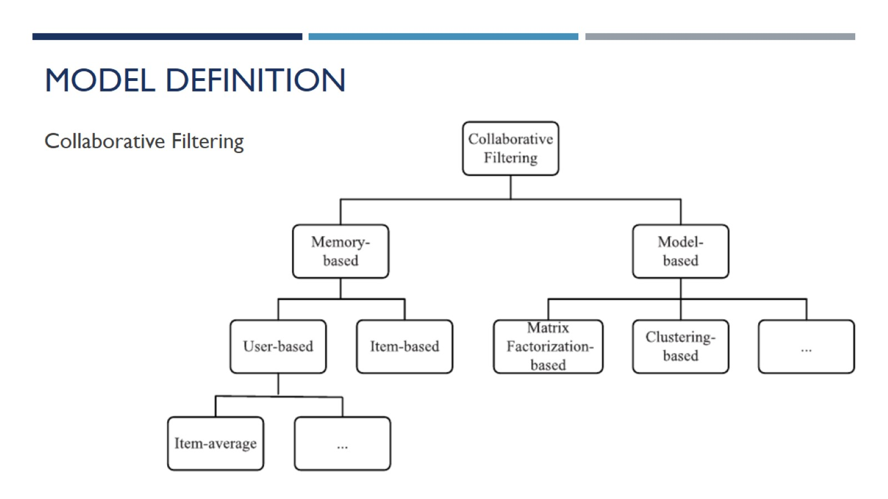
Model definition

Slide 9
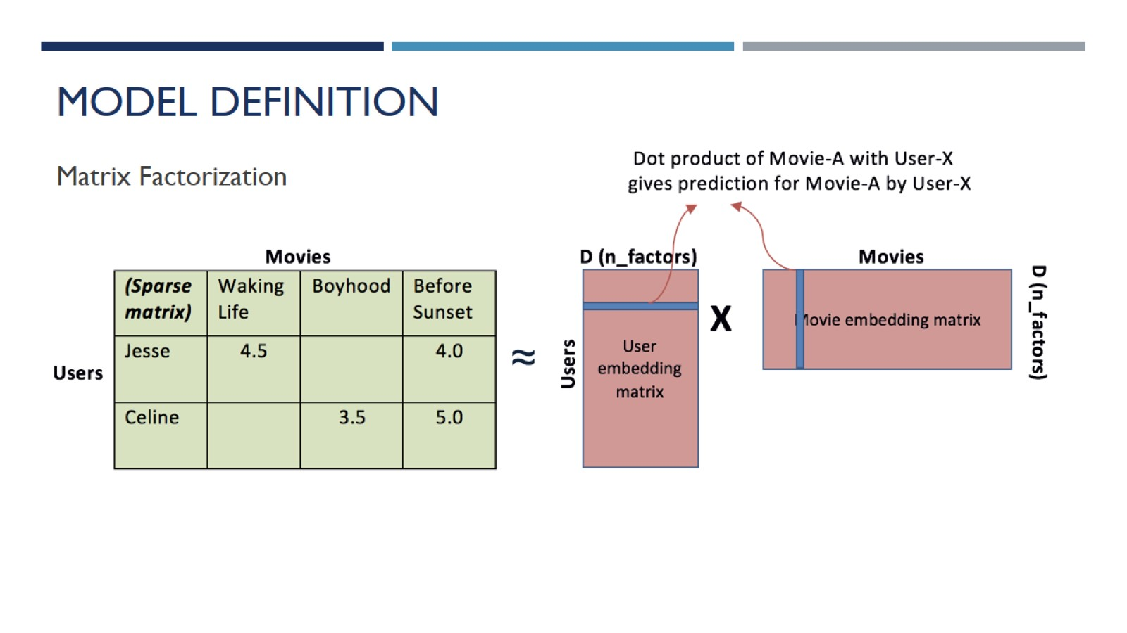
Model definition

Slide 10
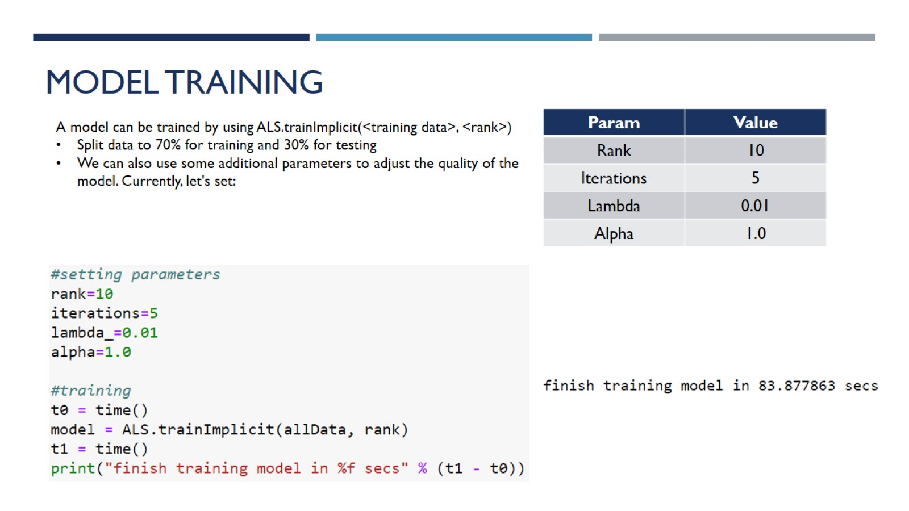
Model Training

Slide 11
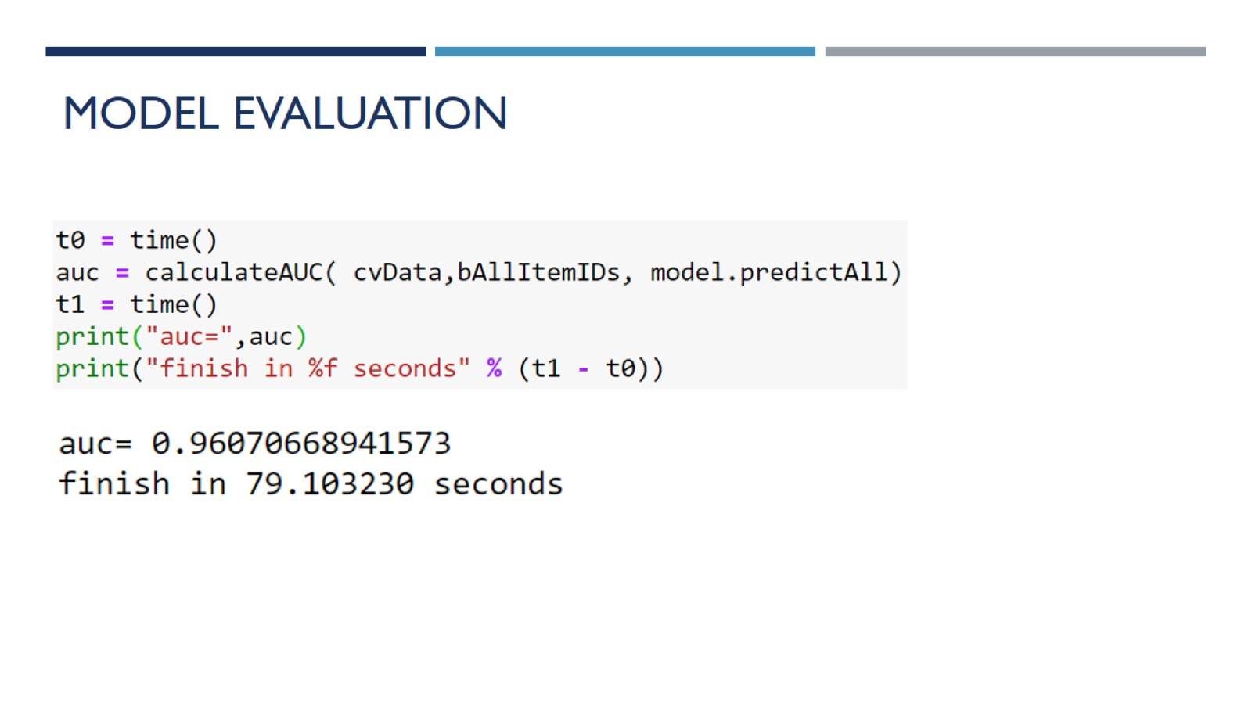
Model Evaluation

Slide 12
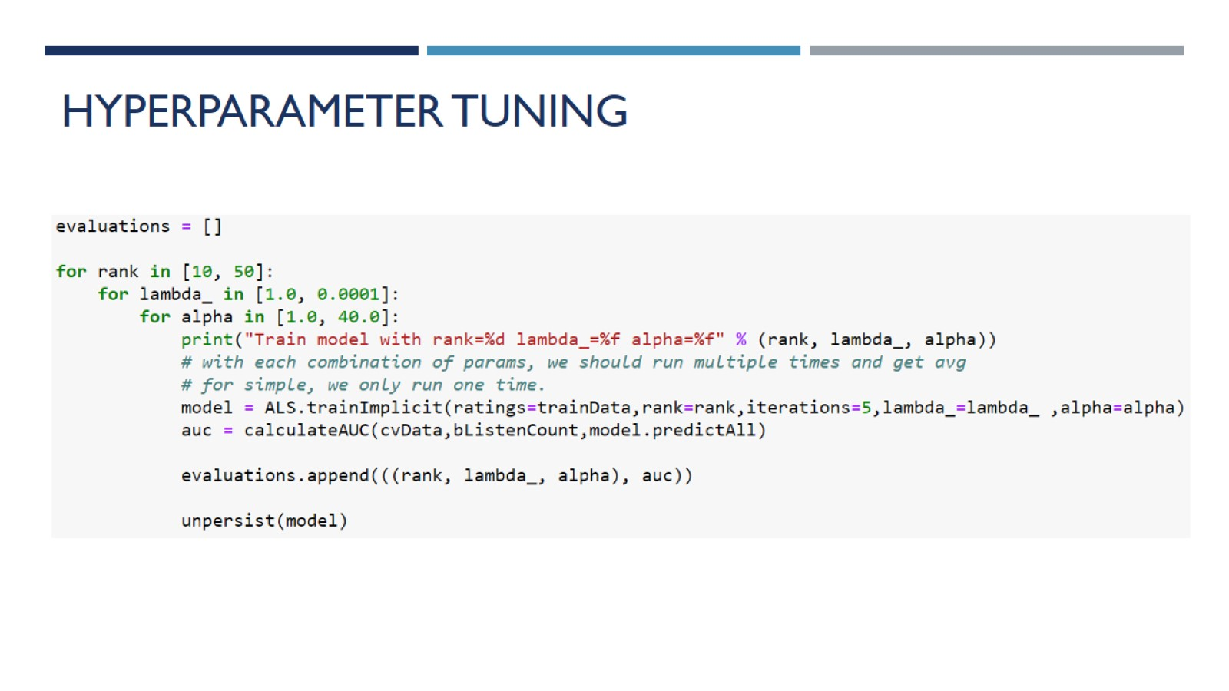
Hyperparameter tuning

Slide 13
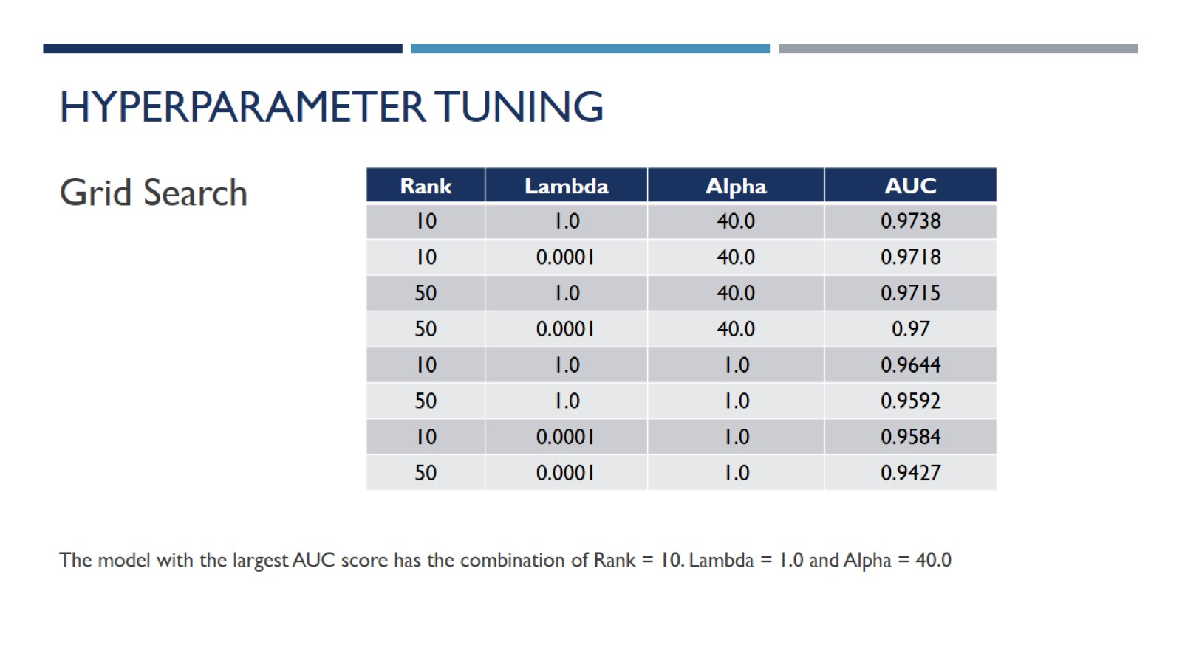
Hyperparameter tuning

Slide 14
IBM Coursera Advanced Data Science Capstone Project
CONCULSION
The model is highly biased on the artists how have number of play counts
We may not need to include lambda and alpha parameters to the model if we only retrieve the top results less than 10 artists.

